Slide 1
Employee Gender Analysis using Excel
STUDENT NAME: VANITHA R
REGISTER NO:312209159 (asunm1353312209159)
DEPARTMENT:B.COM(A&F)
COLLEGE: ANNA ADARSH COLLEGE FOR WOMEN

Slide 2
PROJECT TITLE
Employee Gender Analysis using Excel

Slide 3


AGENDA
Problem Statement
Project Overview
End Users
Our Solution and Proposition
Dataset Description
Modelling Approach
Results and Discussion
Conclusion
3/21/2024 Annual Review

Slide 4

PROBLEM STATEMENT The problem statement for an “Employee Gender Analysis” might look like this: In our organization, there is a need to understand the distribution and dynamics of gender among employees to ensure gender diversity and equality. Currently, there is limited visibility into how gender representation varies across different departments, roles, and levels of seniority.

Slide 5

PROJECT OVERVIEW
For an employee overview:
Data Collection: Gather comprehensive gender-related data from the organization's HR systems.
Data Analysis: Analyze the data to uncover gender distribution patterns, compare them across different organizational segments, and identify any discrepancies.
Reporting: Develop detailed reports and visualizations to communicate findings to stakeholders, highlighting areas of concern and opportunities for improvement.
Recommendations: Provide actionable insights and recommendations to leadership for promoting gender diversity, ensuring equal opportunities etc. for all the employees.

Slide 6

WHO ARE THE END USERS? The end users for the Employee Gender Analysis Data 1. Human Resources (HR) 2. Executive Leadership/Management 3. Diversity and Inclusion (D&I) terms. 4. Department Heads/Managers

Slide 7

OUR SOLUTION AND ITS VALUE PROPOSITION For the “Employee Gender Analysis” project, the value and its value proposition could be framed as follows: Our Value Solution; The value of the “Employee Gender Analysis” project lies in its ability to provide a clear, data-driven understanding of gender diversity within the organization. Value Proposition: The “Employee Gender Analysis” project offers a strategic advantage by empowering the organization with actionable insights into gender diversity.

Slide 8
Dataset Description The data which I used for this analysis, which I download from Kaggle There are 8 feature in the data (e.i) 1. emp ID 2. Name 3. Gender 4. Department 5. Salary 6. Start date 7. Employee type 8. work location

Slide 9

THE "WOW" IN OUR SOLUTION 1. Filtering- removing blanks. Conditional formatting. 2.highlighting blanks and ‘null’ text. 3.pivot table- Gender analysis summary. 4.Bar graph- Final report.
3/21/2024 Annual Review
9

Slide 10
MODELLING Data set
Table: Border
Table Colour.
Conditional formatting:
Highlighting data that contains blanks and null text.
Filtering:
Filtering all the highlighting cells.
Pivot table:
Create pivot table by selecting gender and salary to analysis the salary to each gender in the organisation.
Final Report:
Bar graph for the clear visualization.
10

Slide 11
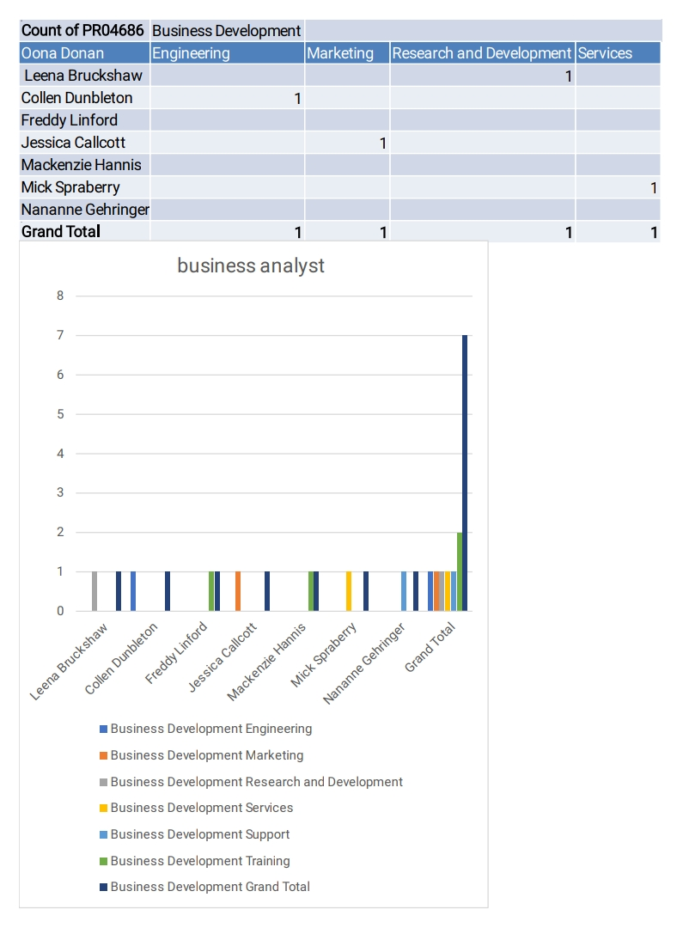
RESULTS
11

Slide 12
Conclusion In conclusion, the Employee Gender Analysis project offers vital insights into gender representation, enabling stakeholders to identify disparities and drive positive change. By leveraging the data, the company can promote a more inclusive workplace, align with diversity goals, and enhance employee satisfaction. This project not only supports compliance with legal requirements but also strengthens the organization’s commitment to gender equality and overall workplace diversity.

